Slide 1
DATA-DRIVEN SUPPLY CHAIN MANAGEMENT AND LOGISTICS · CASE STUDY BOSSARD × D ONE
SmartBin Cloud:
wake up for picks,
not for noise
THE ANSWER IN THREE NUMBERS
−61% / −55%
weighings with the recommended rule (20 kg / 6 kg scales)
55%
How every scale can learn its own sensor sensitivity – from 7.6 million weighings
of the empty wake-ups of normally working scales coincide with a pick at the same site – beyond chance
1.5% → 27%
1.5% of the scales were stuck in a trigger loop and caused 27% of all automatic weighings
Erenalp Çakıroğlu · MSc Applied Information and Data Science, HSLU
Notes:
Time: 30 seconds.
Bossard's SmartBin scales weigh a bin every time a vibration sensor wakes them up. Today three out of four of these weighings find nothing.
The question of the case: how should the sensor sensitivity be set?
Our answer in one sentence: there is no single right setting – every scale has to learn its own, from data the cloud already has.
The three numbers on the right are the story: half the weighings can go, more than half of the empty wake-ups come from picking nearby, and a tiny group of broken scales caused a quarter of the load.
Key line: "Wake up for picks, not for noise."

Slide 2
THE PROBLEM
Three out of four automatic weighings find nothing
76%
A worker picks
from a bin
The vibration sensor
wakes the scale
The scale weighs
(≈ 3,000× sleep
power)
New stock level
to ARIMS →
replenishment
of 7.1 million automatic weighings were empty
13.5 vs. 1.5
Too sensitive → empty wake-up
Too insensitive → missed pick
empty wake-ups vs. real picks per week – typical 20 kg scale on the factory default (level 8)
Label TOO_MANY. Battery, radio network, IoT cloud and ARIMS do work for nothing.
Label TOO_FEW. The stock level stays wrong until a later weighing finds the change.
6% / 19%
of the 20 kg / 6 kg scales meet both Bossard targets
The case question: which parameters matter – and how should the sensitivity (1–10) be set so that a scale wakes up for picks, not for noise?
Source: own analysis of the Bossard SmartBin data, 1 Mar – 20 Jun 2022 · case description Bossard / D ONE (2026) · Report §2, §4.1
2
Notes:
Time: 1 minute.
How a SmartBin works: a worker picks, the vibration sensor wakes the scale, the scale weighs and sends the new stock level to ARIMS, which reorders.
A weighing is expensive: about 3,000 times the sleep power, plus radio, cloud and ARIMS traffic.
Two ways to fail. Too sensitive: the scale wakes up and nothing changed – TOO_MANY. Too insensitive: it sleeps through a pick and the stock is wrong until a later weighing – TOO_FEW.
Today the balance is clearly off: 76% of all automatic weighings are empty. The typical 20 kg scale wakes up empty 13.5 times a week for 1.5 real picks.
Only 6% of the 20 kg and 19% of the 6 kg scales meet both targets.
Key line: "The sensor is set for safety – and pays for it with noise."

Slide 3
DATA AND APPROACH
7.6 million weighings, cleaned and then measured scale by scale
7.6 M
18,455
16 weeks
7,846
weighings
scales at customer sites
1 March – 20 June 2022
scales moved off level 8 in April: a natural experiment
1
Clean
2
Measure
3
Explain
4
Decide
Delete what is broken: 5,733 duplicate copies, 5 impossible weights. Flag, don't delete, rows unfit for KPIs (no label, unknown level, short periods) – they stay in the weight chain. 69% of the rows enter the KPI analysis.
One record per scale and level; the median is the 'typical scale'. Pooled rows would let a few noisy scales dominate.
Timing of empty wake-ups against picks at the same site, detection by pick size, site tests, a loop detector.
Same scale before vs. after the switch, minus the trend of scales that stayed on 8 (difference-in-differences); a simulator for 9 policies.
Built to be rerun: Python + DuckDB pipeline (about one minute on a laptop), tested on a synthetic fleet with known ground truth; Power BI reads only aggregated tables.
Source: own analysis of the Bossard SmartBin data, 1 Mar – 20 Jun 2022 · Report §2–3, Appendix A
3
Notes:
Time: 1 minute.
The data: 7.6 million weighings of 18,455 scales over 16 weeks in 2022. Each weighing is labelled: real pick, empty wake-up, nothing missed, or a missed change.
Four steps. Clean: we delete only what is technically broken – 5,733 duplicate copies and 5 impossible weights. Everything else that is unfit for the KPIs is flagged but kept, because the next weighing needs it to compute the weight change.
Measure: one record per scale and level, summarised with the median. Otherwise a handful of noisy scales would drive every number.
Explain and decide: the strongest evidence comes from April, when Bossard moved 7,846 scales away from level 8. We compare each of them with itself and with the scales that stayed on 8.
Key line: "We let the data run its own experiment."

Slide 4
DASHBOARD
Fleet overview: how far today's scales are from the targets
POWER BI DASHBOARD A
Page 1 – fleet overview: KPIs by scale type and sensitivity level, consistency of every level, share of scales in target
Insert a screenshot of Power BI page 1 here · data: fact_device_sensitivity.csv (one row per scale and level, built by the pipeline)
Source: Power BI report on the aggregated pipeline output (fact_device_sensitivity.csv)
4
Notes:
Time: 1 minute (live or screenshot).
Walk through the dashboard in three clicks: the KPI cards (fraction and TOO_FEW per scale type), the level filter, and the consistency chart that shows how wide the spread is within every level.
Point out: whatever level you pick, the spread inside the level is wider than the difference between levels – the first hint that one setting for all cannot work.
Key line: "The level matters – but where and how a bin is used matters more."

Slide 5
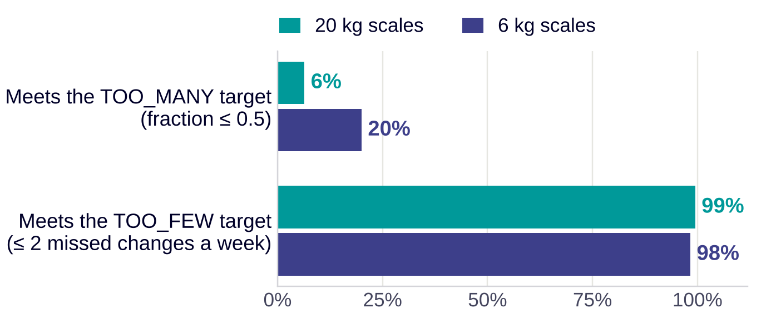
FINDING 1 · THE TARGETS
The problem is one-sided – and the KPI points the wrong way
WE PROPOSE: KPI 2.0
Measure the load and the service directly
KPI per scale | Target | Why
Empty wake-ups per week | ≤ 7 | battery, radio and cloud pay per weighing
Share of changes missed = TOO_FEW ÷ (picks + TOO_FEW) | ≤ 10% | the service the customer feels
TOO_FEW per week | ≤ 2 | Bossard's floor, kept
Misses are rare today: 99% / 98% of the scales meet the TOO_FEW target on level 8. There is room to lower the sensitivity.
The fraction hides progress: level 8 → 1 removes 97% / 98% of the empty wake-ups, but the fraction falls only by 0.23 / 0.20 – real picks vanish too.
It punishes slow movers: least-used fifth of the 20 kg bins 1.00, most-used fifth 0.63.
Absolute counts instead of a ratio: a slow-moving bin is no longer punished, and switching the sensor off no longer looks like success.
Source: own analysis of the Bossard SmartBin data, 1 Mar – 20 Jun 2022 · same scales before and after the switch (difference-in-differences) · Report §4.1, §4.3, §4.4, §6.1
5
Notes:
Time: 1.5 minutes.
First finding: the problem is one-sided. Almost every scale meets the TOO_FEW target, almost none the TOO_MANY target. So the real question is how far we can lower the sensitivity before we start missing picks.
Second: Bossard's KPI, the TOO_MANY fraction, is the wrong compass. It divides two numbers that both fall when you lower the sensitivity. On level 1 the sensor is practically off – yet the fraction looks better.
Third: the fraction punishes slow-moving parts. A bin that is picked once a week can never have a good fraction.
So we propose KPI 2.0: count empty wake-ups per week, and measure the share of real changes that were missed. That is what the battery and the customer actually feel.
Key line: "Count what costs money, not a ratio."

Slide 6
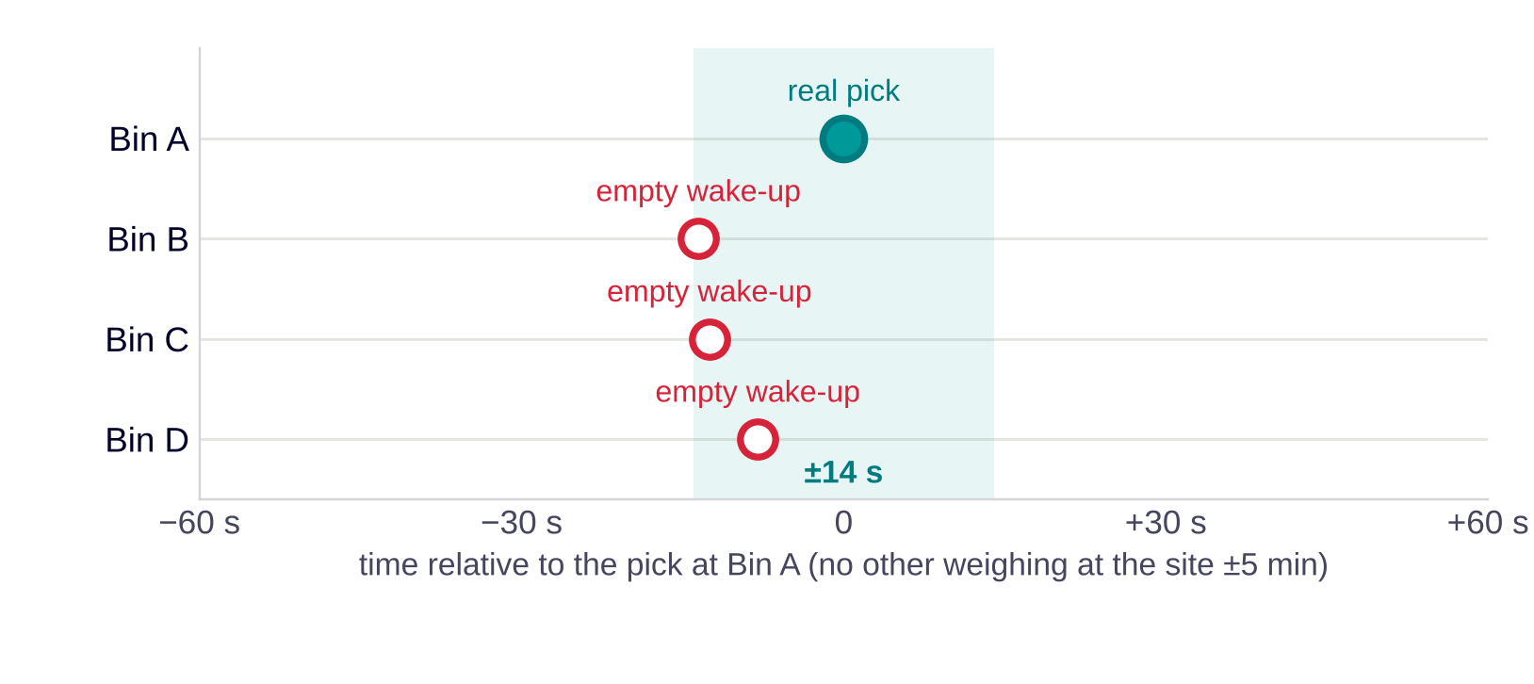
FINDING 2 · KEY INSIGHT
Over half the empty wake-ups coincide with picking nearby
ONE EXAMPLE FROM THE DATA
55%
of the empty wake-ups of normally working scales come within ±14 s of a real pick at another bin of the same site – beyond chance (20 kg: 55%, 6 kg: 56%)
What it means
The sensor reacts to activity at the rack, not only at its own bin.
A lower sensitivity filters part of it; the rest needs mechanics (damping).
The rest (about 45%) has no link to picking nearby – it stays unexplained.
One pick at Bin A. Three neighbouring bins of the same site wake up 8–14 s before it and find nothing (level 8, 21:00).
Source: own analysis of the Bossard SmartBin data, 1 Mar – 20 Jun 2022 · event coincidence analysis (Donges et al., 2016); scales in a trigger loop left out · Report §4.5
6
Notes:
Time: 1.5 minutes. This is the key insight – slow down here.
Here is one real moment from the data: a worker picks from Bin A. Within seconds three neighbouring bins wake up, weigh, and find nothing.
This is not a rare story. For every empty wake-up we looked for a real pick at another bin of the same site in a window of plus or minus 14 seconds. After subtracting what you would expect by chance, 55% of the empty wake-ups of normally working scales are linked to picking nearby.
What does it mean? The sensor reacts to the rack, not only to its own bin. Lowering the sensitivity filters part of it; the rest is mechanical – damping or mounting.
Be honest about the rest: it has no link to picking nearby, and the data cannot tell us what it is.
Transition: "A claim like this needs proof. Here are four tests."

Slide 7
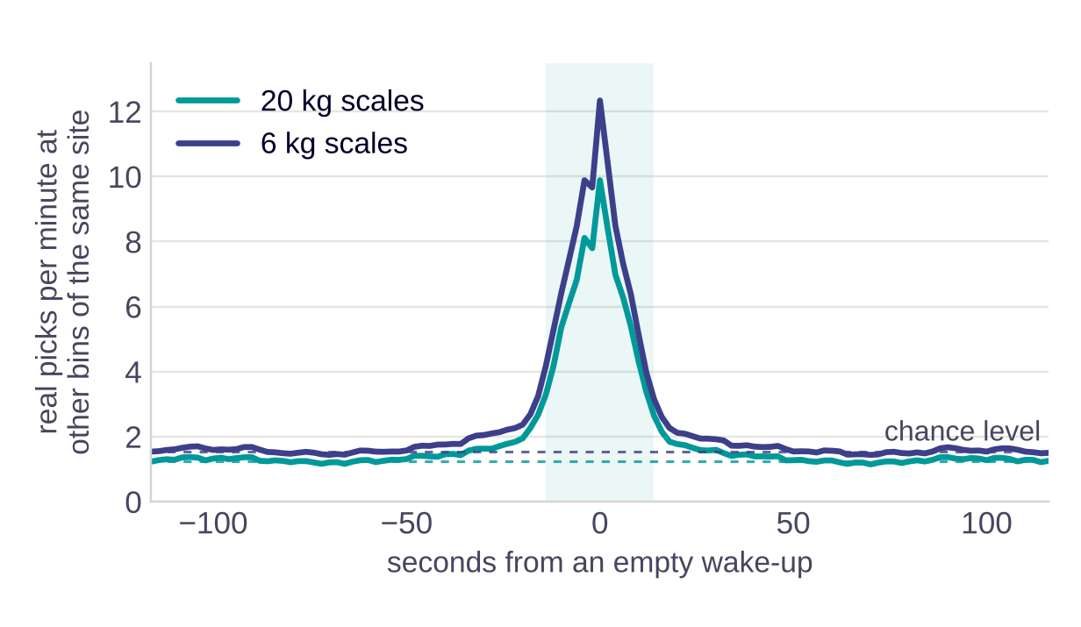
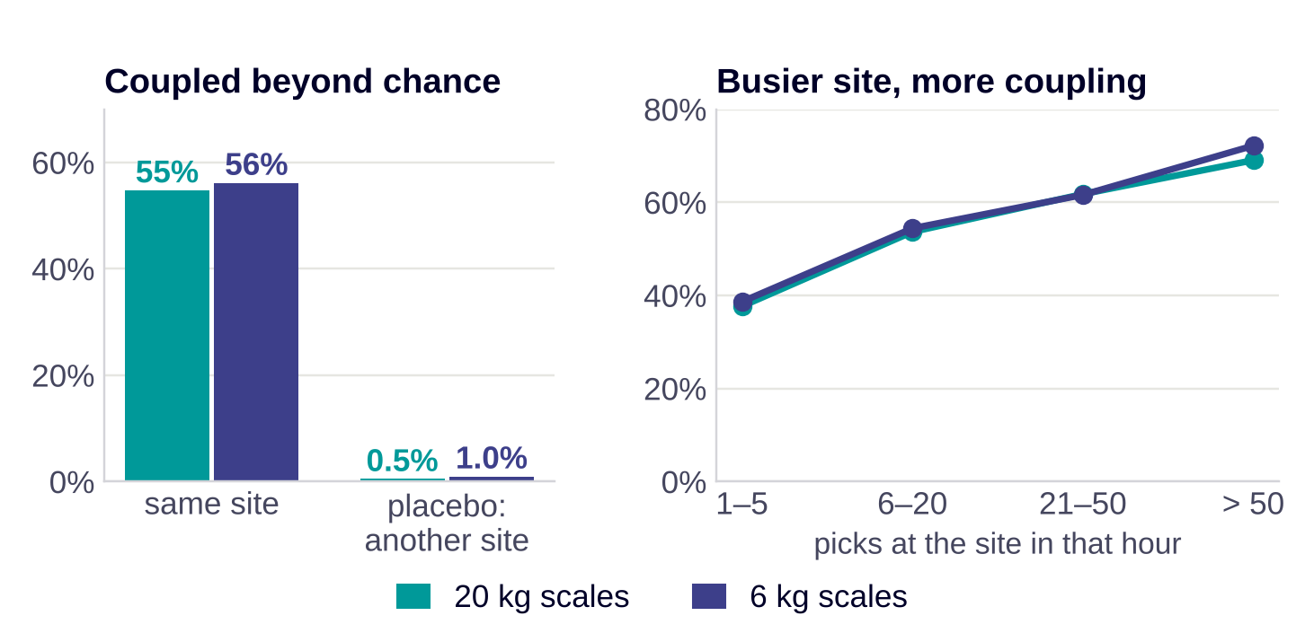
FINDING 2 · EVIDENCE
Four tests show the coupling is not chance
1 · Peak at zero
2 · Chance window
3 · Placebo site
4 · Dose and spread
Picks at other bins jump from 1.2 to 9.9 per minute at the moment of an empty wake-up (20 kg).
In a window 60 s later – same hour, same activity – only 25% have a pick nearby, against 66%.
Picks at another site of similar size at the same second: 0.7% beyond chance. It is local, not the clock.
Coupling rises from 38% to 69% with site activity; 99.8% of the scales are above chance.
Source: own analysis of the Bossard SmartBin data, 1 Mar – 20 Jun 2022 · scales in a trigger loop left out; chance window 60–88 s after the wake-up; placebo = site paired by number of picks · Report §4.5, Appendix C
7
Notes:
Time: 1.5 minutes.
Four tests, each closing a loophole.
One: around an empty wake-up, picks at other bins of the site pile up sharply at zero seconds – from about 1.2 to 9.9 per minute. Both sensors wait the same 30 seconds before they weigh, so the peak sits exactly at zero.
Two: a busy site has picks all the time. So we compare with a window one minute later – same hour, same activity. That is the chance level, and we subtract it.
Three, the placebo: we take picks at a different site of similar size at the same second. If this were just the time of day, the placebo would show the same effect. It shows almost nothing – 0.7 percent.
Four: the busier the site in that hour, the stronger the coupling, and it holds for practically every scale, not for a few.
Limit: the data cannot separate vibration through the rack from a worker touching the bin. A short on-site test with an accelerometer or a damping pad settles that.
Key line: "It is the rack, not the clock."

Slide 8
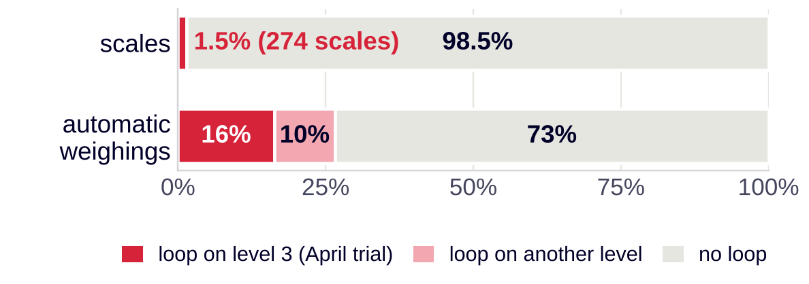
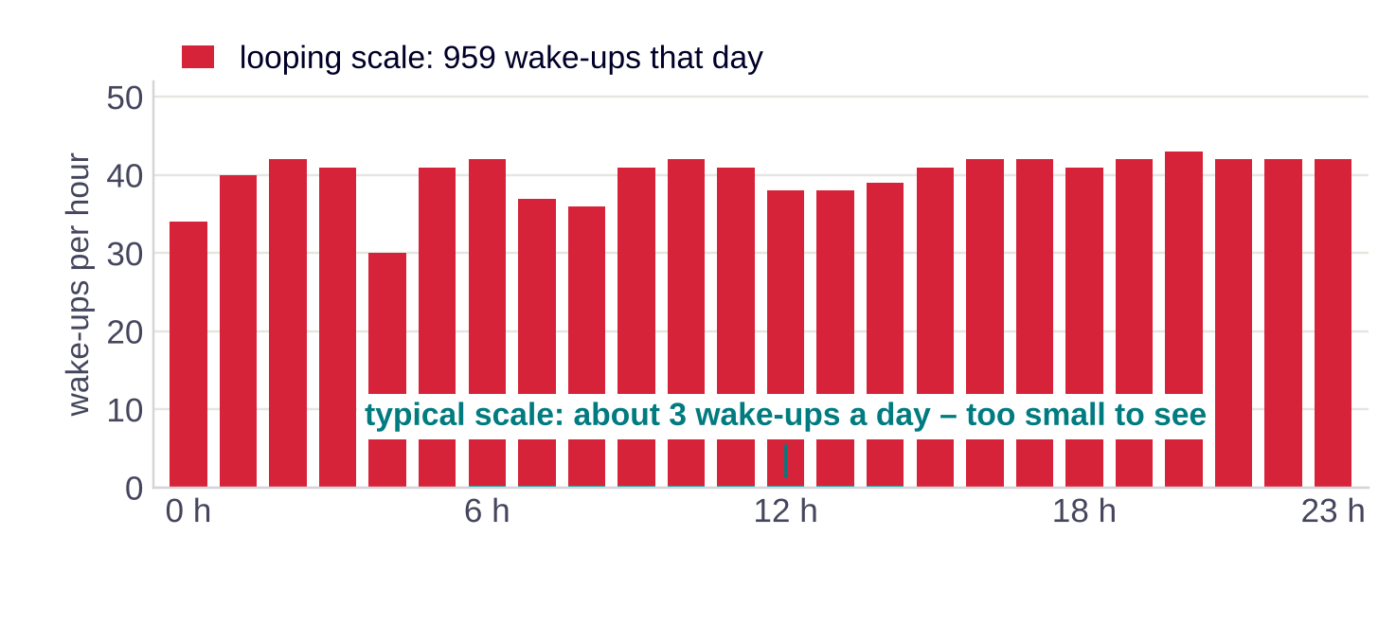
FINDING 3 · A DEFECT, NOT A SETTING
1.5% of the scales were stuck in a loop – and caused 27% of all weighings
ONE LOOPING SCALE, ONE DAY
219 scales looped during the four-week trial of level 3 (April 2022); 59 on other levels still caused 10% of all automatic weighings.
A loop empties a battery designed for five years in 6–14 weeks.
Same picture for any threshold: 24–28% of the weighings.
A wake-up every 90 s, day and night: exactly the minimum wait time (60 s) plus the measurement delay (30 s). The scale triggers itself.
We separated these scales and re-ran every analysis: the findings hold, and the coupling gets stronger (45% → 55%). A different sensitivity is not the fix – service and firmware are.
Source: own analysis of the Bossard SmartBin data, 1 Mar – 20 Jun 2022 · battery: case assumption of ≈ 2 s per weighing at ≈ 3,000× sleep power · Report §5.3, Appendix C
8
Notes:
Time: 1 minute.
Third finding, and the most surprising one: a small group of scales is simply broken. They wake up every 90 seconds, around the clock – that is exactly the minimum wait time plus the measurement delay, so the scale keeps triggering itself.
274 scales, 1.5 percent of the fleet, caused 27 percent of all automatic weighings. Most of them during the four-week trial of level 3 in April – that is why the case says "ignore level 3". But 59 scales looped on normal levels too.
A loop drains a five-year battery in a few weeks.
Important for trust: we took these scales out and re-ran everything. The results hold, and the coupling becomes even clearer, because a looping scale wakes up at night when nobody picks.
Key line: "You cannot tune a broken scale – you flag it."

Slide 9
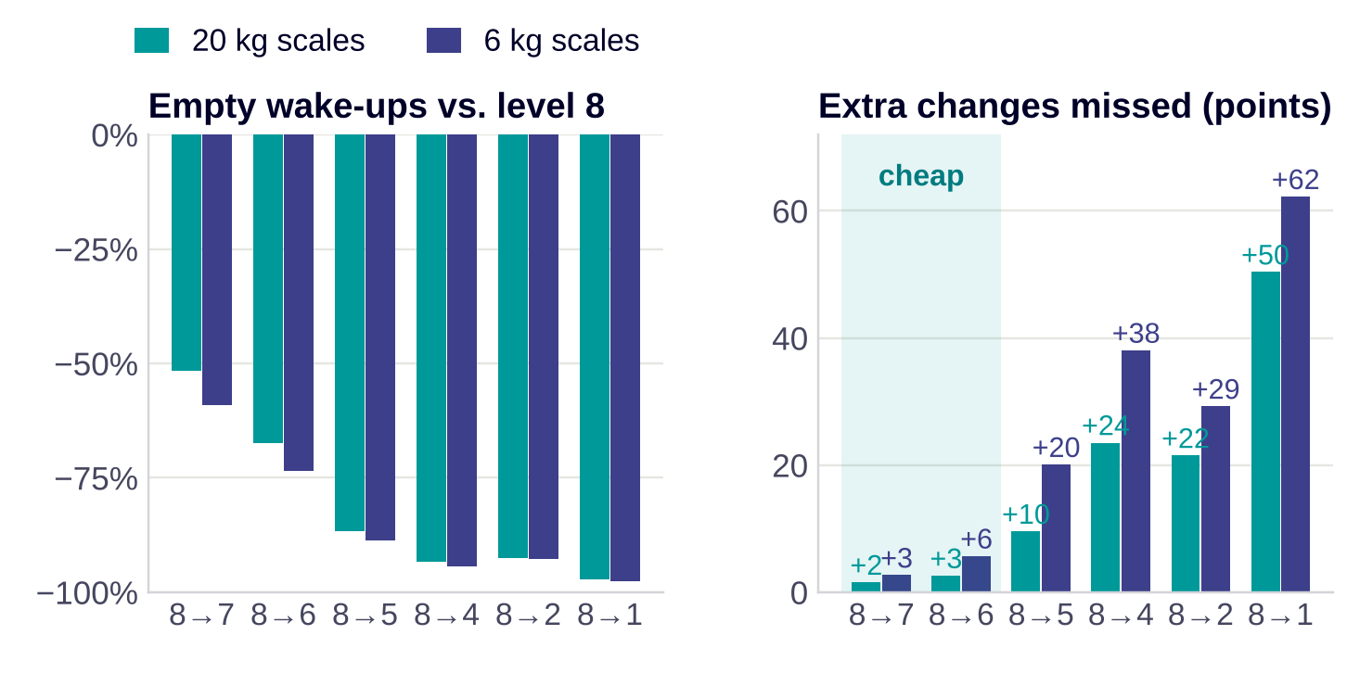
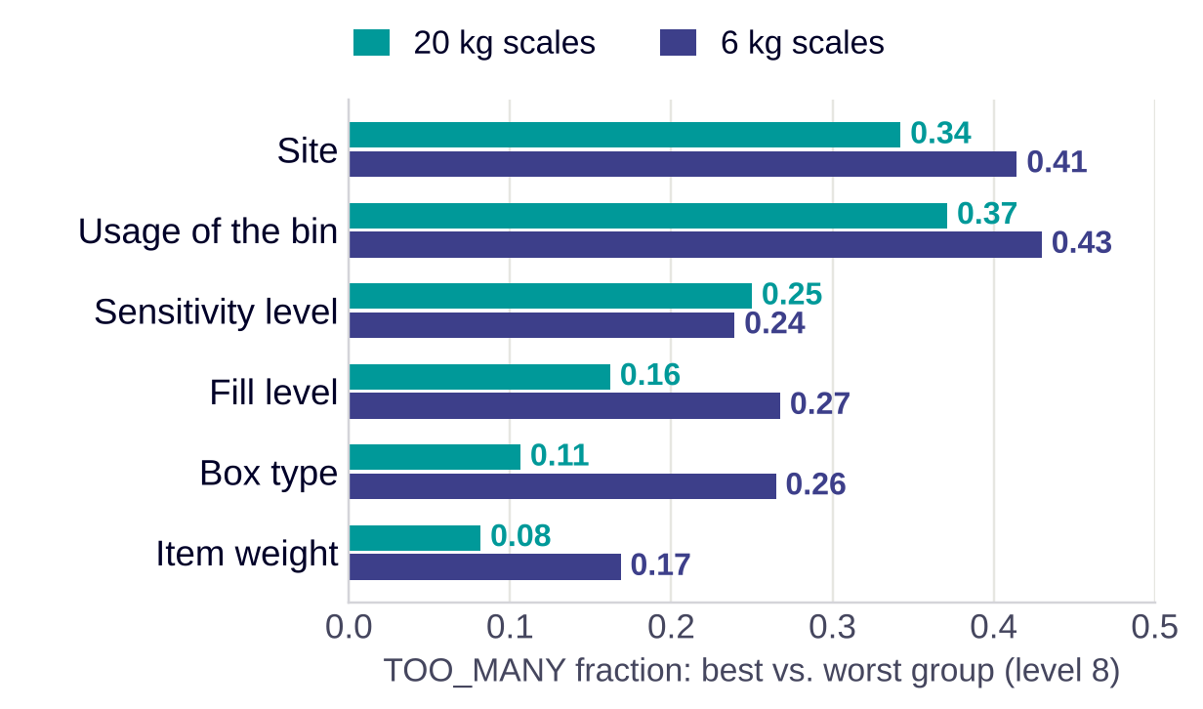
FINDING 4 · THE KNOB
The knob works – but the right level is different for every bin
Same scales before and after the switch: 8 → 7 removes 52% / 59% of the empty wake-ups for 2 / 3 points more misses. Below 6, misses climb steeply.
Site and usage spread the result most; box type and item weight – the facts known before installation – matter little.
So a lookup table cannot carry the setting: a table by pick size picks the same level as 'one level for all' for 95–99% of the scales. Each scale has to learn its level.
Source: own analysis of the Bossard SmartBin data, 1 Mar – 20 Jun 2022 · difference-in-differences with a fixed-effects Poisson model, scales in a trigger loop left out · Report §4.8, §5.1, §6.2
9
Notes:
Time: 1.5 minutes.
Left: what the knob really does, measured on the same scales before and after Bossard switched them, corrected for the trend of scales that stayed on 8. The first step, 8 to 7, removes about 52% to 59% of the empty wake-ups and costs only a few points of misses. Below level 6 the price rises steeply.
Right: what drives the result between scales. Site and usage of the bin dominate. Box type and item weight – the only things Bossard knows before installing a bin – hardly matter.
That is the logical turning point of the project. If the decisive facts only show once the scale runs, no master-data table can set the level. We tested it: a table by pick size ends up choosing the same level as one level for all.
Key line: "The right setting is not in the master data – it is in the scale's own history."

Slide 10
DASHBOARD
Sites and levels: the same setting behaves differently at every site
POWER BI DASHBOARD B
Page 2 – sites × sensitivity level: median TOO_MANY fraction and empty wake-ups per week by site; filter by scale type
Insert a screenshot of Power BI page 2 here · data: fact_device_sensitivity.csv (site, level, KPIs per scale)
Source: Power BI report on the aggregated pipeline output (fact_device_sensitivity.csv)
10
Notes:
Time: 1 minute.
Show one site with a good and one with a bad median on the same level. The differences between sites are large and reproducible: 40 to 42 percent of the variation lies between sites, and two random halves of each site agree closely.
Key line: "Same knob, different factory, different result."

Slide 11
OUR RECOMMENDATION
Flag, tune, watch – three steps on data the cloud already has
FLAG
1 / 3
TUNE
2 / 3
WATCH
3 / 3
Find broken scales every day
Every scale learns its level
Measure what the customer feels
Daily loop detector on every scale and level
Looping scale: back to 7, then service
Level 3 off the menu until the firmware is fixed
Start every scale on level 7
Every two weeks: one step up, one step down or hold
Same rule for 6 kg and 20 kg, reported apart
KPI 2.0 per scale
Keep the existing 24-hour idle check
Watch list for the 10% of scales with most misses
274 scales (1.5%) in the data
weighings −61% / −55%
most misses found within 2 days
NOW
WEEKS 1–8
THEN
Loop detector live · level 3 off the menu · factory default 8 → 7
Pilot the rule at about 10 sites against matched control sites
Roll out; tune the thresholds with the pilot results
Source: own analysis of the Bossard SmartBin data, 1 Mar – 20 Jun 2022 · simulation over 16 weeks, scales in a trigger loop left out of the savings · Report §6.3–6.4
11
Notes:
Time: 1 minute.
Our recommendation has three parts, and none of them needs new hardware.
Flag: a daily rule finds the broken scales and takes them out of the tuning – they go to service.
Tune: every scale starts on level 7 and then moves one step at a time, every two weeks, based on its own empty wake-ups and misses.
Watch: KPI 2.0 per scale, the existing 24-hour check as the safety net, and extra attention for the few scales where misses concentrate.
Roll-out in three phases: the detector and the new default can start now; the rule goes into an eight-week pilot with control sites; then roll out.
Key line: "Flag what is broken, tune what works, watch what the customer feels."

Slide 12
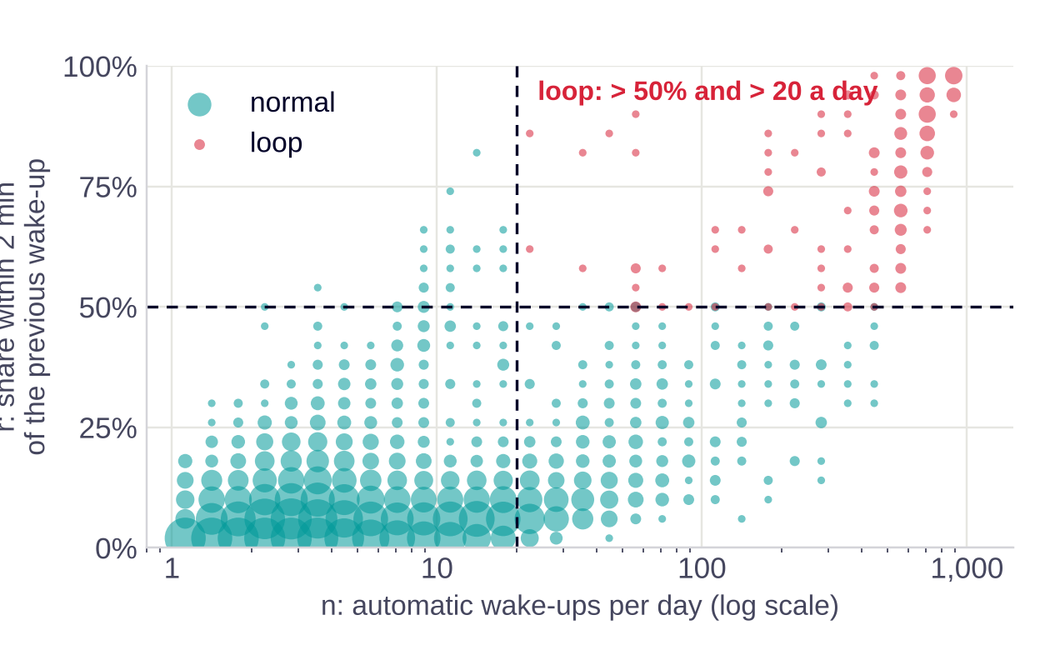
STEP 1 · FLAG
A two-number rule finds the broken scales every day
FOR EVERY SCALE AND LEVEL · LAST 7 DAYS (≥ 5 WITH DATA)
r = wake-ups within 2 min of the previous one ÷ all wake-ups
n = automatic wake-ups per day
Loop ⇔ r > 50% and n > 20
Example (from the data) | n per day | r | Result
Typical looping scale | 630 | 86% | LOOP
Normal scales, 99th percentile | 48 | 30% | normal
Typical scale | 3 | 3% | normal
WHAT HAPPENS NEXT
1
Set the scale back to 7 remotely – as Bossard did for the April switch
2
Still looping after 2 days → service ticket (sensor, battery)
3
List to the firmware team: the 90 s pattern is a firmware loop
Robust: any threshold between 40–60% and 10–80 a day flags 233–330 scales holding 24–28% of the weighings. Delivered as about 20 lines of SQL/Python plus today's list.
Source: own analysis of the Bossard SmartBin data, 1 Mar – 20 Jun 2022 · each dot = scale-levels with similar values, size = number of scale-levels · Report §5.3, Appendix C
12
Notes:
Time: 1 minute.
How do you find a broken scale? Two numbers per scale and level over the last week: r, the share of wake-ups that come within two minutes of the previous one, and n, wake-ups per day. If more than half come in rapid succession and there are more than 20 a day, it is a loop.
The chart shows why this is easy: normal scales and looping scales sit in completely different corners. The typical looping scale wakes up 630 times a day; even the 99th percentile of normal scales stays at about 48 wake-ups a day and 30% quick re-triggers.
What happens then? First, the scale is set back to 7 remotely. If it keeps looping for two days, a service ticket. And the list goes to the firmware team.
We do not send anyone to service ourselves: we deliver the rule as code and today's list; Bossard runs it daily in the cloud.
Key line: "Two numbers, one rule, every day."

Slide 13
STEP 2 · TUNE
Every two weeks, each scale moves one step – or stays
WORKED EXAMPLE · A BUSY 20 KG BIN
EVERY 14 DAYS, PER SCALE
Weeks | Level | E | P | M | m | Decision
1–2 | 7 | 22 | 4 | 0 | 0% | E > 14, m ≤ 5% → down
3–4 | 6 | 15 | 3 | 0 | 0% | E > 14, m ≤ 5% → down
5–6 | 5 | 6 | 2 | 1 | 33% | m > 10% → up
7–8 | 6 | 12 | 3 | 0 | 0% | E ≤ 14 → hold
Count E = empty wake-ups, P = picks caught, M = misses found later
m = M ÷ (P + M)
UP
one level more sensitive · if m > 10% or M > 4
DOWN
one level less sensitive · if E > 14 and m ≤ 5%
HOLD
stay · otherwise
The bin settles on level 6 with about two thirds fewer empty wake-ups than on 8 (46 per two weeks). Counts are illustrative, scaled with the measured effects of the knob.
Start on 7 · range 1–8 · level 3 blocked · thresholds = KPI 2.0 (> 7 a week, > 2 misses a week)
Why this rule: it uses only counts the cloud already has, changes a scale about once a month, and every decision can be audited. Trade-off: the typical scale ends at 11–12% missed (limit 10%) because the rule keeps probing – the pilot tunes the 5% step-down threshold.
Source: own analysis of the Bossard SmartBin data, 1 Mar – 20 Jun 2022 · rule P7 simulated over 8 two-week cycles, 5 replications · Report §6.2–6.4
13
Notes:
Time: 1.5 minutes. This is the method the client takes home – make it concrete.
Every two weeks the cloud counts three numbers per scale: empty wake-ups E, picks caught P, and misses M that a later weighing found. The miss share m is M over P plus M.
Then one of three things happens. Too many misses – more than 10 percent, or more than two a week – one step more sensitive. Many empty wake-ups – more than seven a week – while misses are comfortably low: one step less sensitive. Otherwise: stay.
The example: a busy bin starts on 7, steps down twice, misses one pick on level 5, steps back up to 6 and stays there – with about two thirds fewer empty wake-ups than today.
The honest trade-off: because the rule keeps testing the next level down, the typical scale ends at about 11 percent missed, just above the 10 percent limit. The pilot decides whether to make the step-down stricter.
Key line: "Every scale finds its own level – one step at a time."

Slide 14
STEP 3 · WATCH
KPI 2.0 and the existing 24-hour check keep every miss visible
10% → 55% / 36%
What happens when the sensor misses a pick?
The next weighing finds it – a later wake-up or the 24-hour idle check, which finds 91% of all detected misses.
Found after a median of 33 h (20 kg) / 38 h (6 kg); 83% / 76% within 48 h.
1% take 6–7 days – already today. Alarm when a scale has had no weighing for 48 h.
A one-day delay matters only if that pick crossed the reorder point and the rest lasts less than a day.
the 10% of scales with the most misses produce this share of all misses (20 kg / 6 kg) → they go on a watch list: 12-hour check or one level higher
Not recommended: a nightly check for every scale
It would add 7 weighings per scale and week – 33–40% of what the rule saves – to find misses that the 24-hour check already finds a day later.
Nothing is removed: the existing 24-hour idle check stays as the safety net.
Source: own analysis of the Bossard SmartBin data, 1 Mar – 20 Jun 2022 · time from the previous weighing to a TOO_FEW · Report §3, §6.4
14
Notes:
Time: 1 minute.
The natural worry: if the sensor sleeps more, does stock stay wrong for days?
The data answer it. A missed pick is found by the next weighing – any later wake-up, or the 24-hour idle check that Bossard already runs. That check finds 91% of all detected misses. The median time to find a miss is about a day and a half; three quarters or more are found within two days.
One percent take up to a week – that is today already, probably scales that are offline. A cheap alarm for scales without any weighing for 48 hours closes that gap.
And misses are concentrated: ten percent of the scales produce half of them. Those go on a watch list.
What we do not recommend is a nightly check for every scale – it would eat a third of the savings.
Key line: "We keep the safety net – and point it at the few scales that need it."

Slide 15
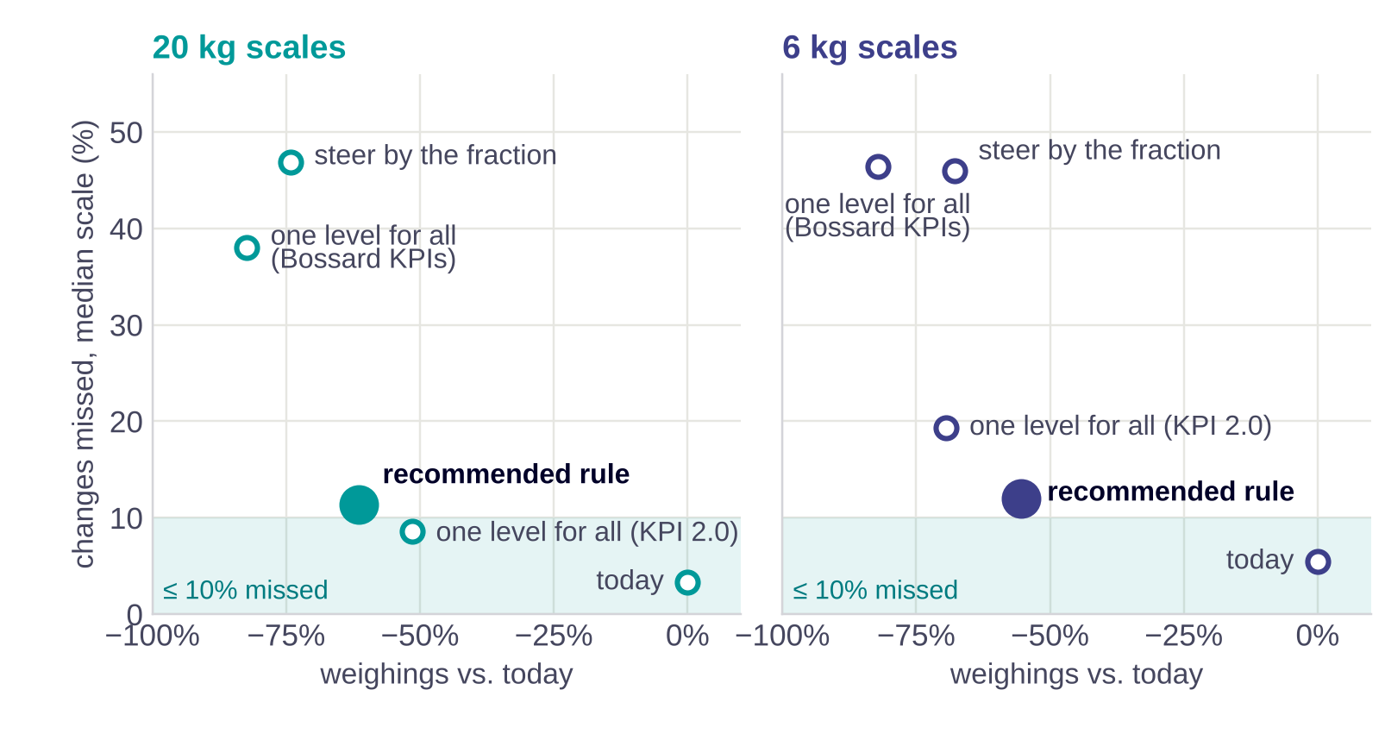
RESULT
Half the weighings – while misses stay low and visible
−61% / −55%
weighings with the rule (20 kg / 6 kg, scales without a loop)
11% / 12%
of the changes missed by the typical scale (simulated today: 3% / 5%)
≈ 2.1 M
weighings saved per week across 110,000 installed scales – an illustration, not a forecast
Battery life +8% / +5%: sleep power dominates. The big gain is on radio, cloud and ARIMS – and on the looping scales.
Same result when the knob effects are estimated without the loop scales: −61% / −55%, 11% / 11% missed.
Source: own analysis of the Bossard SmartBin data, 1 Mar – 20 Jun 2022 · policy simulation with each scale's own level-8 rates × measured rate ratios, 16 weeks · Report §6.3
15
Notes:
Time: 1 minute.
We simulated nine policies on every scale, using each scale's own behaviour and the measured effect of the knob.
The chart shows the trade-off: further left means fewer weighings, higher means more misses. One level for all, tuned to Bossard's KPIs, saves the most – but misses 38 to 46 percent of all changes: it simply switches the sensor off. Steering by the fraction ends in the same place.
Our rule sits in the sweet spot: about 61 and 55 percent fewer weighings, with the typical scale missing about 11 to 12 percent – and those misses are found by the 24-hour check.
Across the installed base that would be roughly 2.1 million weighings a week – an illustration, not a promise.
Key line: "Half the noise, and nothing goes unseen."

Slide 16
ALTERNATIVES
What we tested and did not recommend
Option | What happened in the data or the simulation (20 kg / 6 kg) | Verdict
One level for all, tuned to Bossard's KPIs | −82% / −82% weighings, but 38% / 46% of the changes missed | reject
Steer by the TOO_MANY fraction | 47% / 46% missed: the fraction pushes scales towards level 1 | reject
A table by pick size or item weight | Same level as one-for-all for 95–99% of the scales | no gain
Quiet hours per site | Avoids 6% / 6% of the empty wake-ups; 4% / 5% of the picks fall into them | reject
Nightly check for every scale | Costs 33–40% of the savings | reject
Longer minimum wait time (60 min) | 76% / 82% of these scales sit at two sites; no scale ran both wait times | not measurable
Merge bursts into one weighing (10 min) | −5% / −4% on top of the rule; 25% of the picks reported about 5 min later | optional firmware
The pattern: every shortcut either switches the sensor off or ignores what makes each bin different. A rule that learns per scale avoids both.
Source: own analysis of the Bossard SmartBin data, 1 Mar – 20 Jun 2022 · quiet hours learned on March–April and tested on May–June · Report §6.3, §6.5
16
Notes:
Time: 1 minute – or skip and keep for questions.
We tested the obvious shortcuts. One level for everyone looks great on Bossard's KPIs and misses almost half of the changes. Steering by the fraction does the same.
Quiet hours sound attractive, but empty wake-ups follow the working day exactly like real picks – so you would block real picks too.
A nightly check for every scale eats a third of the savings. A longer wait time could not be measured, because it was only used at two sites.
Merging bursts is not wrong – it is an optional firmware item that adds a few percent.
Key line: "Every shortcut either switches the sensor off or ignores what makes each bin different."

Slide 17
NEXT STEPS
An eight-week pilot turns the simulation into a decision
NOW
PILOT · WEEKS 1–8
IN PARALLEL
LIMITS
One season (Mar–Jun 2022)
Observational: busier scales were switched first
TOO_FEW is a lower bound of misses
No rack positions in the data
Loop detector runs daily
Level 3 off the setting menu
Factory default 8 → 7
KPI 2.0 in the dashboard
Rule at ~10 sites vs. matched control sites
Weekly KPI 2.0 per scale
Test the step-down threshold: 5% vs. 3% missed
Accelerometer / damping test at the 10 most coupled sites
Firmware fix for loops
Confirm the idle-check rule and the meaning of the levels
Decision for Bossard today: start the loop detector and the new default 7 now – low risk, measured effect. Let the pilot decide the rule's thresholds.
Source: own analysis of the Bossard SmartBin data, 1 Mar – 20 Jun 2022 · Report §7–8
17
Notes:
Time: 1 minute.
What should Bossard do on Monday? Two things are low-risk and can start now: run the loop detector, and change the factory default from 8 to 7 – we measured that step on hundreds of scales.
The rule itself goes into an eight-week pilot at about ten sites, each compared with a matched control site. The pilot also decides how strict the step-down threshold should be.
In parallel: a vibration test at the sites with the most coupling, a firmware fix for the loops, and three facts we inferred from the data and want Bossard to confirm.
Limits, briefly: one season of data, the switch was not randomised, and TOO_FEW undercounts misses. That is exactly why we recommend a pilot, not a big-bang roll-out.
Key line: "Start the safe part now, let the pilot decide the rest."

Slide 18
THANK YOU
Questions?
FLAG
a two-number rule finds broken scales every day
TUNE
every scale learns its level, one step every two weeks
WATCH
KPI 2.0, the 24-hour check and a watch list keep misses visible
Backup: data cleaning · robustness without loop scales · methods · pick size · code · dashboard C · references
Erenalp Çakıroğlu · code, report and pipeline in a private repository (case data under NDA)
Notes:
Leave this slide up during questions. Backup slides answer the likely technical questions: data cleaning, robustness without the loop scales, methods, pick size, the code and the KPI 2.0 dashboard.

Slide 19
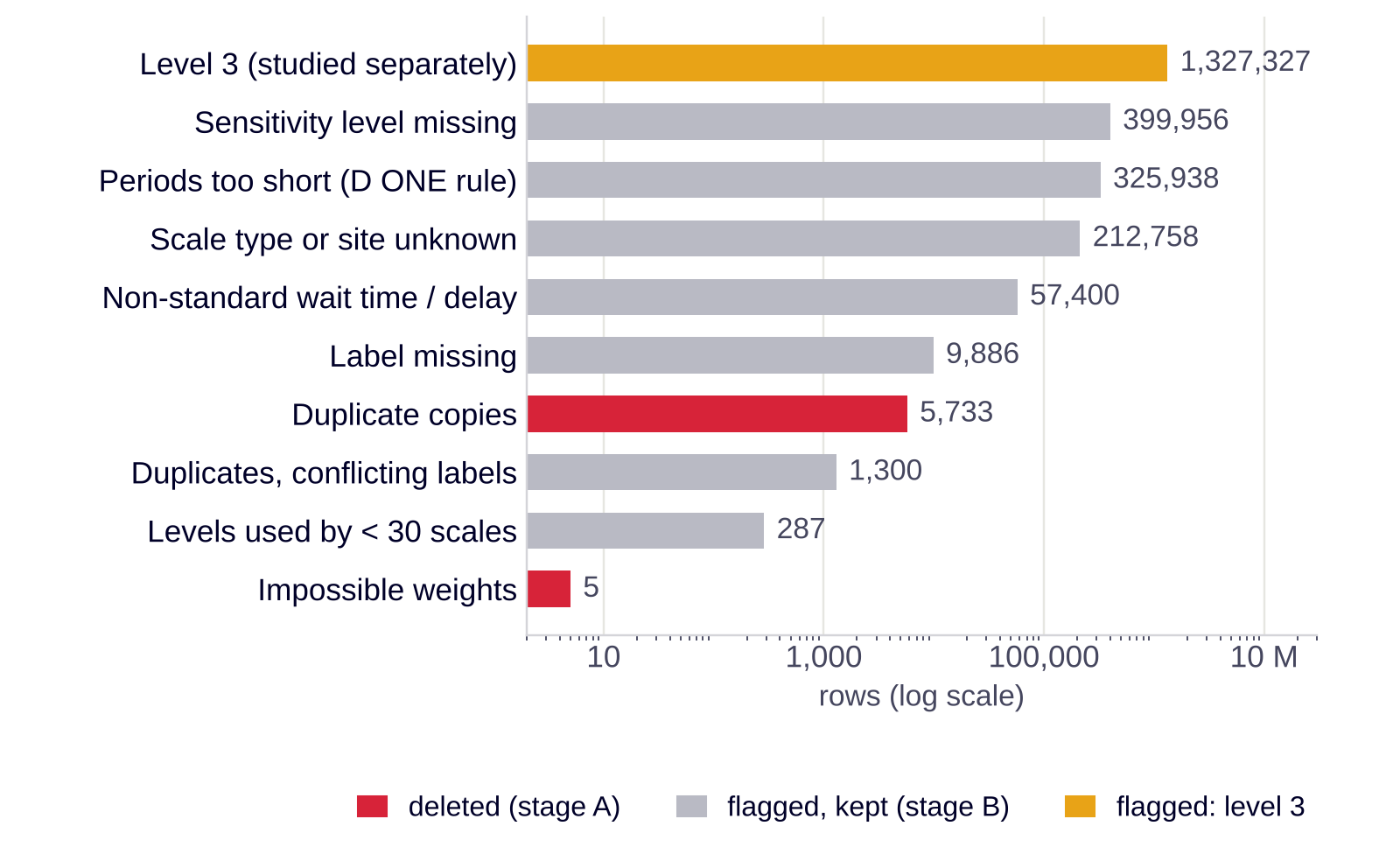
BACKUP · DATA CLEANING
Delete only what is broken – flag the rest and keep the chain intact
Duplicates: 5,733 copies with the same scale and millisecond. In 1,300 of 5,499 groups the copies carry different labels – one copy stays for the weight chain, its outcome counts as unknown.
Impossible weights: 5 rows (144 kg to 50 t) – exactly those D ONE marked invalid.
Why flag instead of delete: a weighing with an unknown level is useless for the KPI, but the next weighing needs it to compute its weight change, and it can be the pick that woke a neighbour.
Checks: D ONE's 'relevant period' rule re-computed on all 58,700 periods (100% match); empty wait-time values behave like the standard.
Result: 5.26 M rows (69%) enter the KPI analysis; every excluded row is exported with its reason.
Source: own analysis of the Bossard SmartBin data, 1 Mar – 20 Jun 2022 · Report §3, Appendix A
19
Notes:
Likely question: 'Did you check for duplicates?' Yes – and they were not all identical, which is why conflicting copies keep the weight chain but lose their label.

Slide 20
BACKUP · ROBUSTNESS
The findings hold when the 274 loop scales are left out
Result | All scales | Without loop scales
Typical scale on level 8: empty wake-ups per week (20 kg / 6 kg) | 13.5 / 8.5 | 13.5 / 8.4
Typical TOO_MANY fraction on level 8 | 0.92 / 0.74 | 0.92 / 0.74
Empty wake-ups coupled to picking nearby | 45% | 55%
8 → 7: empty wake-ups | −59% / −68% | −52% / −59%
8 → 6: empty wake-ups | −56% / −79% | −67% / −74%
Recommended rule: weighings vs. today | −61% / −55% | −61% / −55%
Recommended rule: changes missed (typical scale) | 11% / 12% | 11% / 11%
Why the coupling rises: a looping scale wakes up around the clock, also when nobody picks – its wake-ups dilute the link. Why the knob estimate moves: a few loop scales that were switched carried very large counts. The recommendation does not change.
Source: own analysis of the Bossard SmartBin data, 1 Mar – 20 Jun 2022 · report/robustness_loops.py · Report Appendix C
20
Notes:
Question: 'Should the broken scales not be removed first?' Yes – this slide shows every key number with and without them. Medians and the recommendation are unchanged; the coupling gets stronger.

Slide 21
BACKUP · METHODS
Four methods, each answering one question
Does the knob cause the change?
Are empty wake-ups linked to picks?
Difference-in-differences on 7,846 switched scales: each scale after vs. before, minus the trend of scales that stayed on 8 over the same weeks. Counts with a fixed-effects Poisson model, so each scale's own baseline cancels. 95% bootstrap intervals.
Event coincidence analysis: a = (p_near − p_chance) ÷ (1 − p_chance); near = ±14 s (width of the peak), chance = 60–88 s later; placebo with a paired site.
How small a pick can a scale see?
Which policy is best?
Weight change behind every label; threshold = 5th percentile of the missed changes (≈ 23 g / 5 g); detection rate per pick size and level.
Simulator: each scale's own level-8 rates, shrunk towards its type, × the measured rate ratios; 9 policies, 16 weeks, 5 replications; back-test on the real switchers.
Angrist & Pischke (2009) · Donges et al. (2016) · Green & Swets (1966) · Report §5.1, §4.5, §4.6, §6.3, Appendix A
21
Notes:
Use only if asked about a method. The simulator is somewhat optimistic in the back-test and predicts single scales only roughly – it compares policies, it is not a forecast.

Slide 22
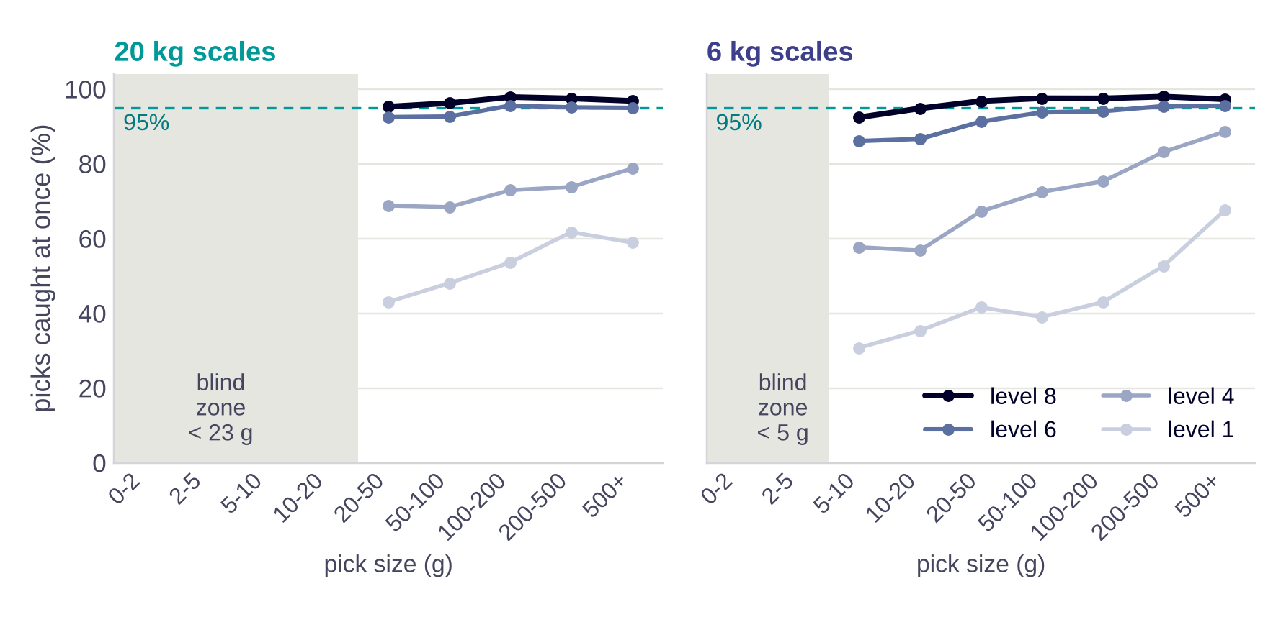
BACKUP · PICK SIZE
Below about 25 g, a 20 kg scale is practically blind
Threshold: about 23 g (20 kg) and 5 g (6 kg) – picks below it are invisible.
Levels 1–5 never reach 95% detection for any pick size.
Placement rule: parts picked in amounts below about 25 g belong on 6 kg scales.
Source: own analysis of the Bossard SmartBin data, 1 Mar – 20 Jun 2022 · threshold = 5th percentile of the weight change of missed changes · Report §4.6
22
Notes:
Question: 'Does the pick size matter?' Yes for placement, not for a table: the efficient level is 6–8 for almost every pick size, which is why the rule starts on 7.

Slide 23
BACKUP · CODE
One pipeline from raw file to deck – rerun in about a minute
Module | What it does
io · cleaning | load 7.6 M rows into DuckDB; stage A deletes, stage B flags with a reason
features · tables | event chain (previous weight, gap, change); one record per scale and level
analysis M1–M7 | baseline, knob (DiD), parameters, sites, pick size, coupling, policy simulator
M0 validation | synthetic fleet with known physics: the pipeline must recover it first
powerbi · report | aggregated tables for Power BI; figures, report and both decks
robustness_loops | every key result again without the loop scales, placebo test, examples
Run it
bash run_bossard.sh
python report/build_figures.py
python report/robustness_loops.py
quarto render report/report.qmd
python presentation/build_cto_deck.py
NDA: raw and row-level data and Power BI files never enter the repository; only aggregated tables do.
Source: project repository (private)
23
Notes:
For the data scientists in the room: everything is reproducible from the three raw files.

Slide 24
BACKUP · DASHBOARD
KPI 2.0 monitoring: which scales need attention this week
POWER BI DASHBOARD C
Page 3 (optional) – KPI 2.0 per scale: empty wake-ups per week, share of changes missed, watch list of the scales with the most misses
Insert a screenshot of Power BI page 3 here · data: fact_device_sensitivity.csv
Source: Power BI report on the aggregated pipeline output (fact_device_sensitivity.csv)
24
Notes:
Optional: shows how the WATCH step would look in operation.

Slide 25
REFERENCES
Sources
Anastasi, G., Conti, M., Di Francesco, M., & Passarella, A. (2009). Energy conservation in wireless sensor networks: A survey. Ad Hoc Networks, 7(3), 537–568. https://doi.org/10.1016/j.adhoc.2008.06.003
Angrist, J. D., & Pischke, J.-S. (2009). Mostly harmless econometrics: An empiricist's companion. Princeton University Press.
Bossard AG. (n.d.). SmartBin Cloud. Retrieved 6 October 2026, from https://www.bossard.com/ch-en/smart-factory-logistics/systems/smartbin-cloud/
Bossard AG & D ONE Solutions AG. (2026). Smart Factory Logistics – SmartBin Cloud [Lecture slides, case description and case data]. HSLU, module Data-driven Supply Chain Management and Logistics. Confidential (NDA).
Chapman, P., Clinton, J., Kerber, R., Khabaza, T., Reinartz, T., Shearer, C., & Wirth, R. (2000). CRISP-DM 1.0: Step-by-step data mining guide. SPSS Inc.
Donges, J. F., Schleussner, C.-F., Siegmund, J. F., & Donner, R. V. (2016). Event coincidence analysis for quantifying statistical interrelationships between event time series. The European Physical Journal Special Topics, 225(3), 471–487. https://doi.org/10.1140/epjst/e2015-50233-y
Green, D. M., & Swets, J. A. (1966). Signal detection theory and psychophysics. Wiley.
Grömping, U. (2006). Relative importance for linear regression in R: The package relaimpo. Journal of Statistical Software, 17(1), 1–27. https://doi.org/10.18637/jss.v017.i01
Shrout, P. E., & Fleiss, J. L. (1979). Intraclass correlations: Uses in assessing rater reliability. Psychological Bulletin, 86(2), 420–428. https://doi.org/10.1037/0033-2909.86.2.420
Strathern, M. (1997). 'Improving ratings': Audit in the British university system. European Review, 5(3), 305–321.
25
Notes:
All sources cited on the slides. Case data are confidential and used under the module NDA.

